Slide 1
CAPSTONE PROJECT
BOOK CONNECT
BY AVIWE KOLI

Slide 2
USER EXPERIENCE TO ACHIEVE:
As a user, I want to view a list of book previews, by title and author, so that I can discover new books to read.
As a user, I want an image associated with all book previews so that I can recognize a book by the cover even if I forgot the name.
As a user, I want to have the option of reading a summary of the book so that I can decide whether I want to read it.
As a user, I want to have the option of seeing the date that a book was published so that I can determine how easy it is to obtain second-hand.
As a user, I want to find books based on specific text phrases so that I don’t need to remember the entire title of a book.
As a user, I want to filter books by author so that I can find books to read by authors that I enjoy.
As a user, I want to filter books by genre so that I can find books to read in genres that I enjoy.
As a user, I want to toggle between dark and light modes so that I can use the app comfortably at night.

Slide 3
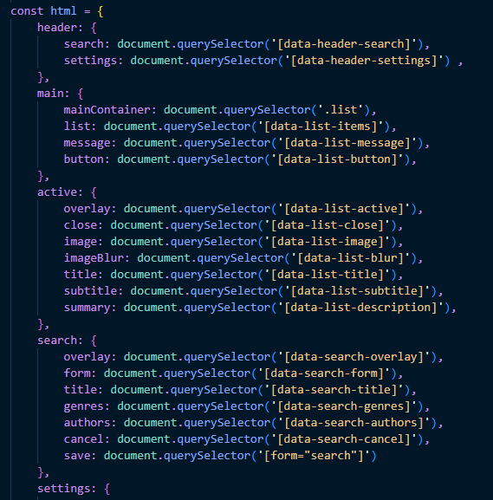
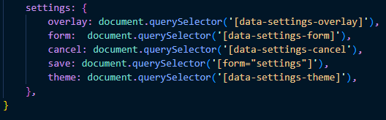
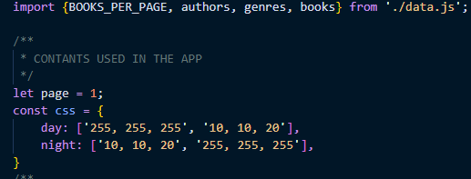
PROJECT PROPS

Slide 4
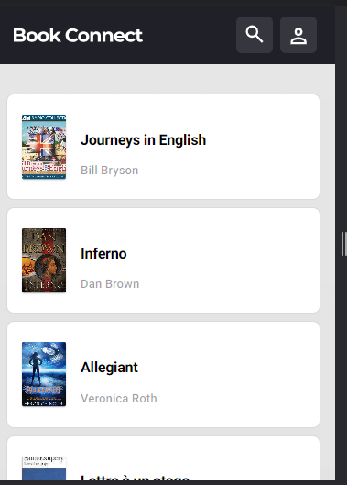
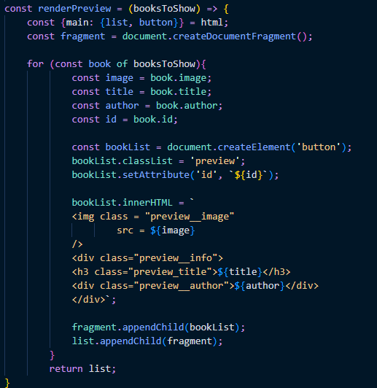
Initial Rendering of the page:

Slide 5
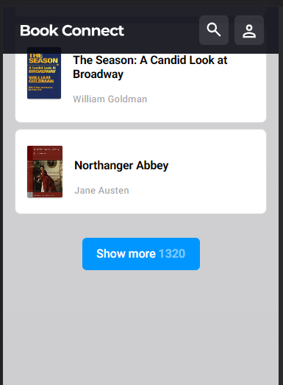
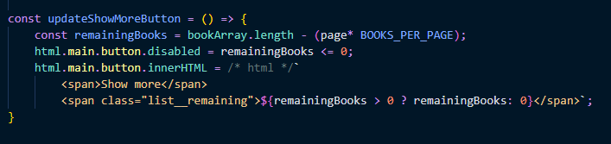
Show More Button:
The show more button allows the user to render or load more book into the page and display the number of books remaining

Slide 6
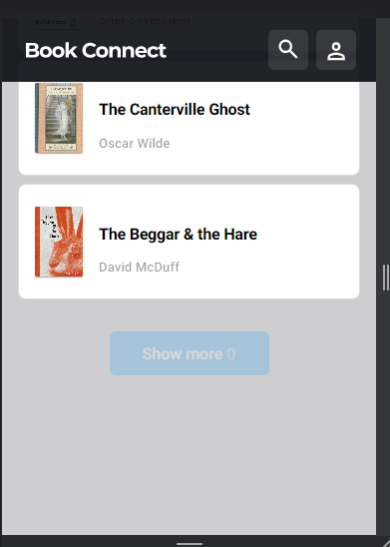
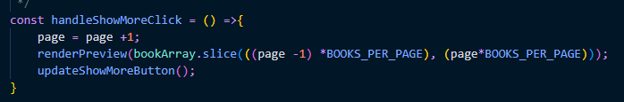
After loading all books:
When all the books have been loaded, the button is disabled

Slide 7
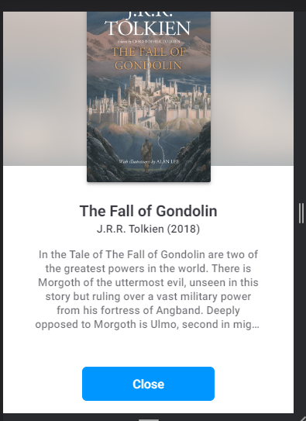
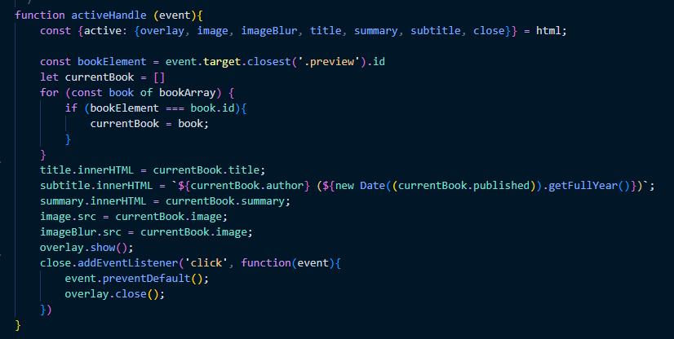
Book Preview:
A book preview which displays the book details:

Slide 8
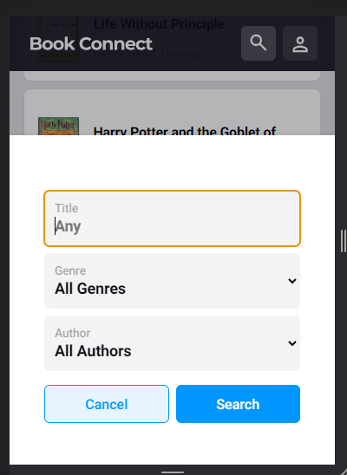
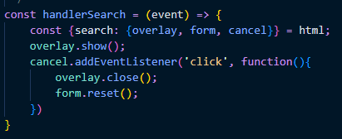
Book filter/ Search:
A dialog pop-up or overlay that display when the search button is clicked

Slide 9
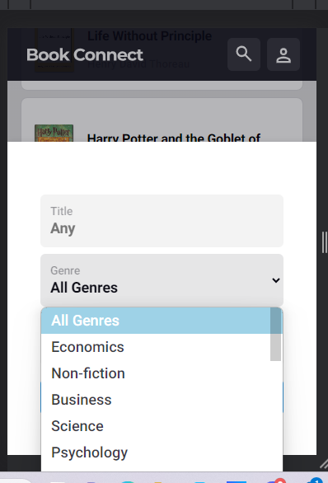
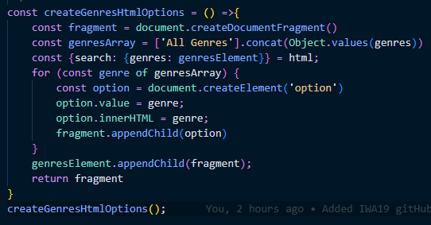
Genres Options:
Function that populates the DOM with genre options

Slide 10
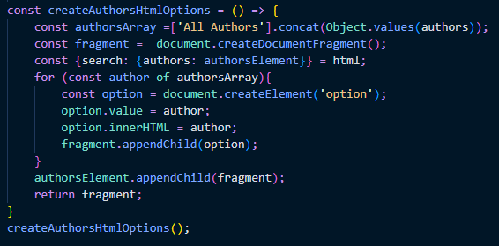
Author options:
A code snipped that populates the DOM with Author Options

Slide 11
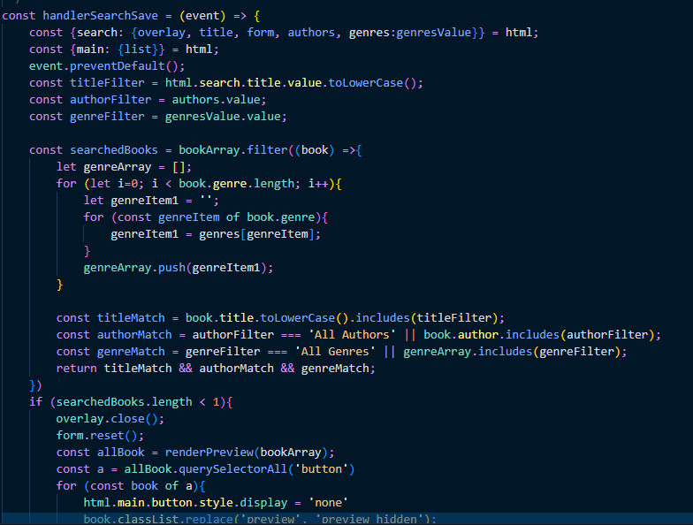
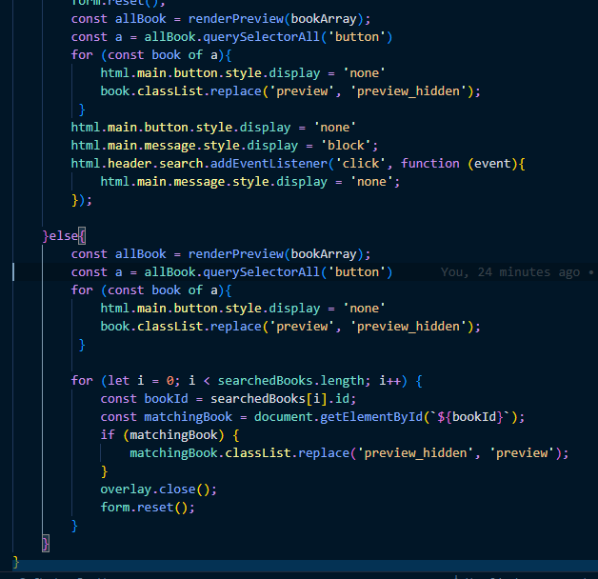
Search submit:

Slide 12
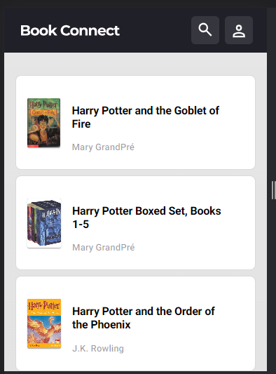
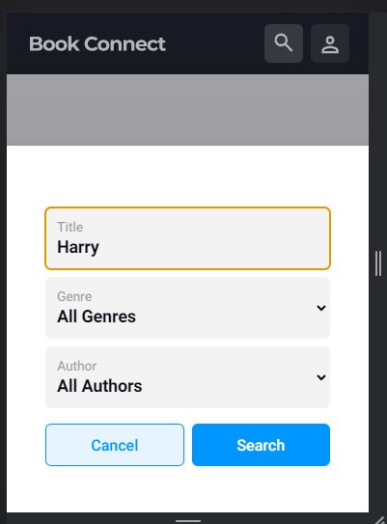
Search Example:

Slide 13
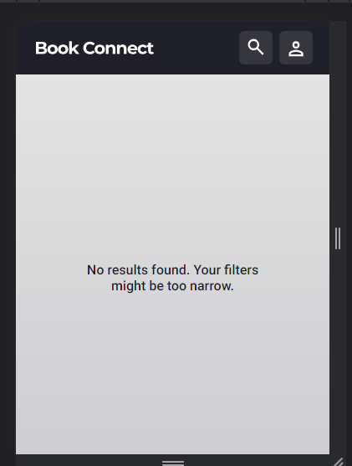
Search Example Part2
This shows what happens when no matches are found:

Slide 14
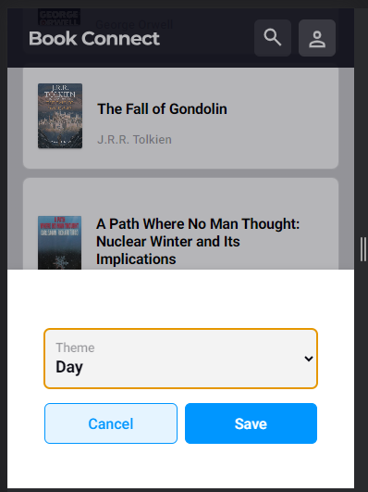
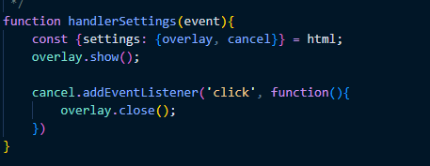
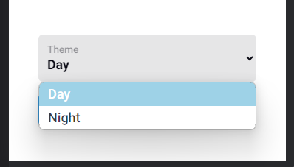
Theme Settings:
The dialog overlay that pops up that allows the user to toggle between
Dark and light mode settings.

Slide 15
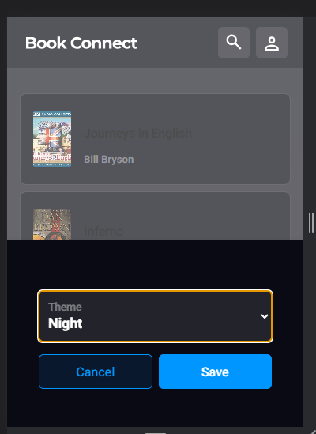
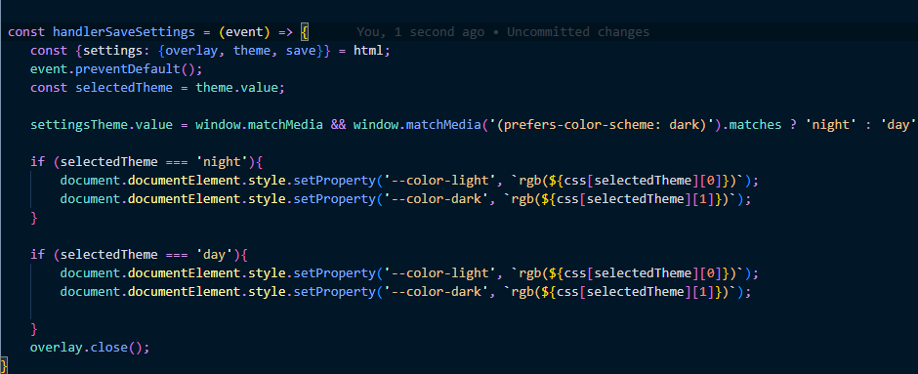
Applying theme Settings:
A code snipped of the function that applies a theme chosen by the user

Slide 16
THANK YOU!

